Slide 1
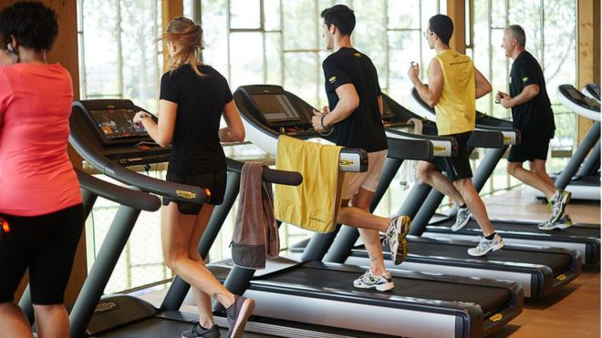
GYM CROWDEDNESS
GROUP 66: PRARTHANA SHAH(A20351168)
SINDHU REDDY(A20359823)

Slide 2
CONTENTS
INTRODUCTION
MATTER OF CONCERN
DATA DESCRIPTION
APPROACH
LEARNING AND FUTURE SCOPE
REFERENCES

Slide 3
INTRODUCTION
In today’s sedentary lifestyle, it is very important for people to work-out for overall fitness and health
It’s helpful to know the best timing to visit the gym

Slide 4
MATTER OF CONCERN
To build a best model for prediction
To know the pattern of people over past 1.5 years and forecasting the same
To know the best time to go to the gym
To know the period of the year that attracts more students to the gym

Slide 5
DATA DESCRIPTION
Data
Temperature
(Low, Medium, High)
Day
(Weekend, Weeekday)
Number of People
(Low, Average, High)
Month
(Summer, Fall, Winter, Spring)
Hour
(Morning, Afternoon, Evening, Night)
The dataset consists of 26,000 people counts taken at about every 10 minutes over the last 1.5 year (from August 2015 to March 2017)

Slide 6
APPROACH
Ordinal Logistic Regression Analysis
Time Series Analysis
Data Visualization

Slide 7
ORDINAL LOGISTIC REGRESSION (OLR)
Built model using backward elimination, stepwise function with backward and both direction, best subset method with adjr2 and Cp metric.
Obtained same model with all 8 X-variables with same AdjR2 value

Slide 8
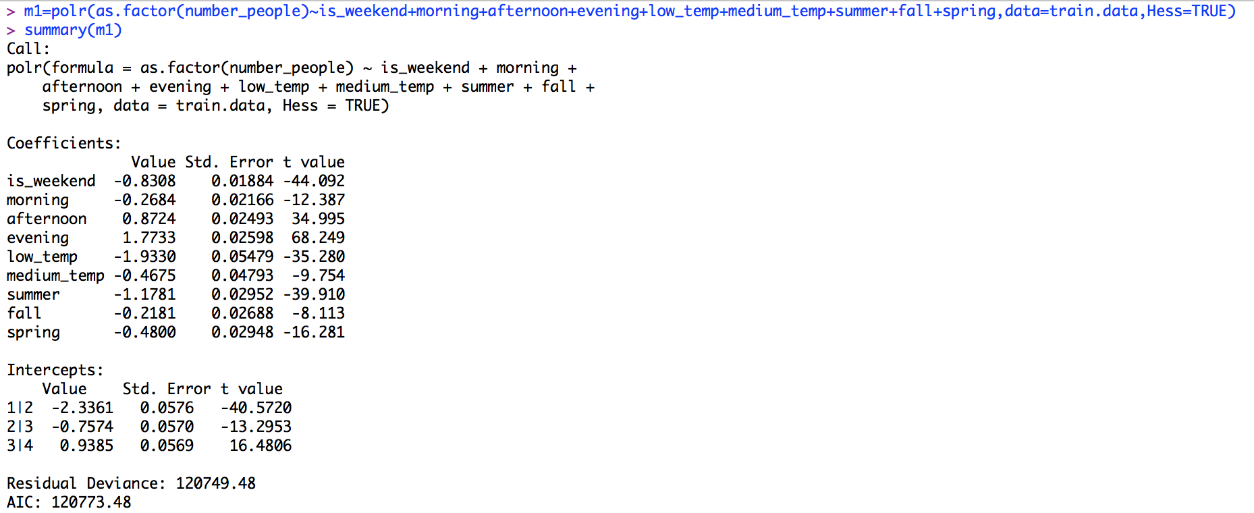
OLR MODEL

Slide 9
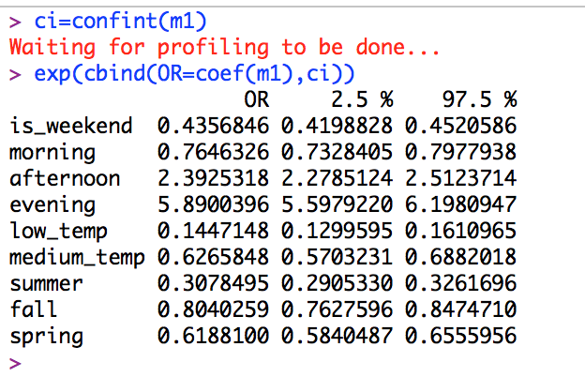
ODDS RATIO

Slide 10
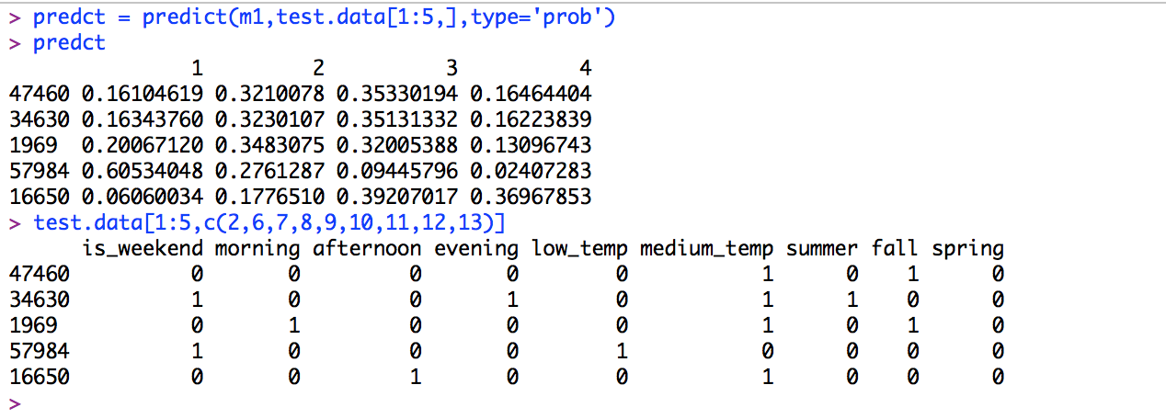
PREDICTING TEST DATA

Slide 11
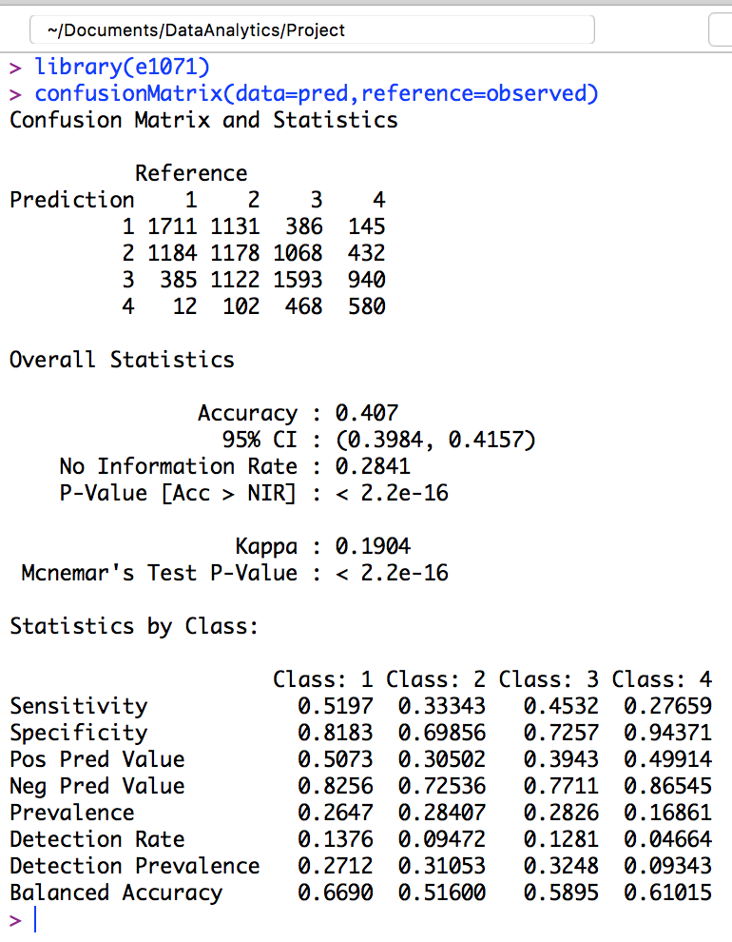
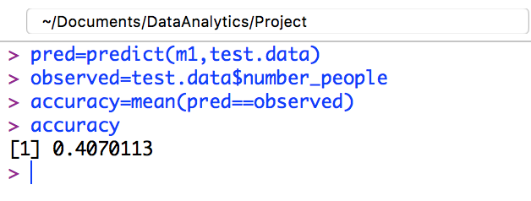
ACCURACY

Slide 12
TIME SERIES ANALYSIS- DATEWISE
Model | AIC
ARIMA(5,0,0) | 3385.54
AR(7) | 3281.08
AR(12) | 3256.97
MA(7) | 3343.89

Slide 13
MODEL EVALUATION
Model | MAE
ARIMA(5,0,0) | 18.51985
AR(7) | 19.44326
AR(12) | 19.23435
MA(7) | 19.84554

Slide 14
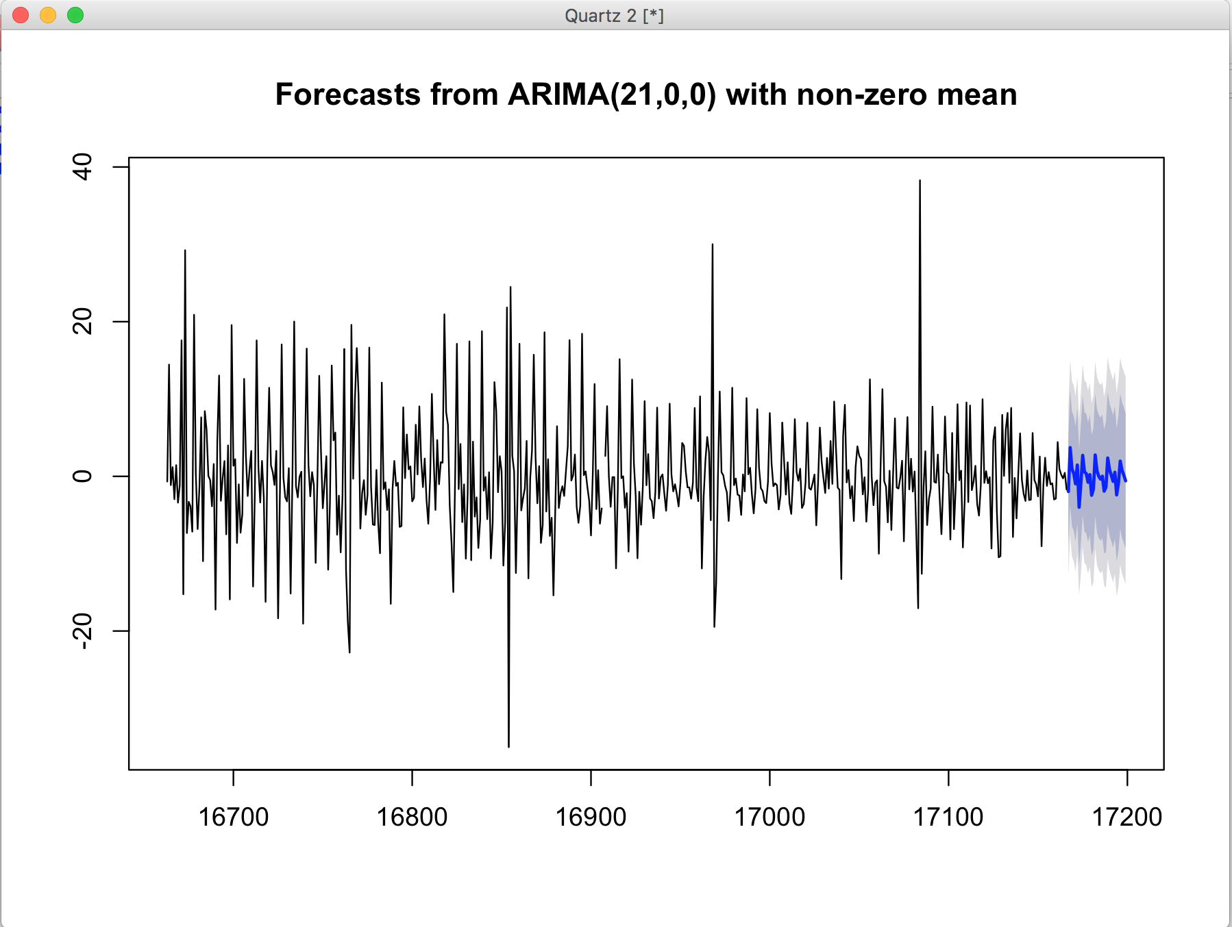
FORECASTING

Slide 15
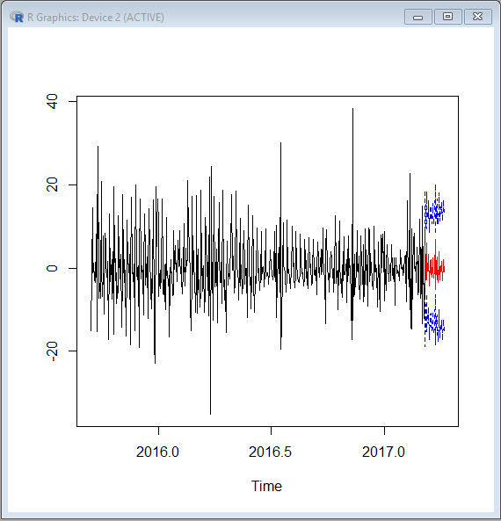
Continued…

Slide 16
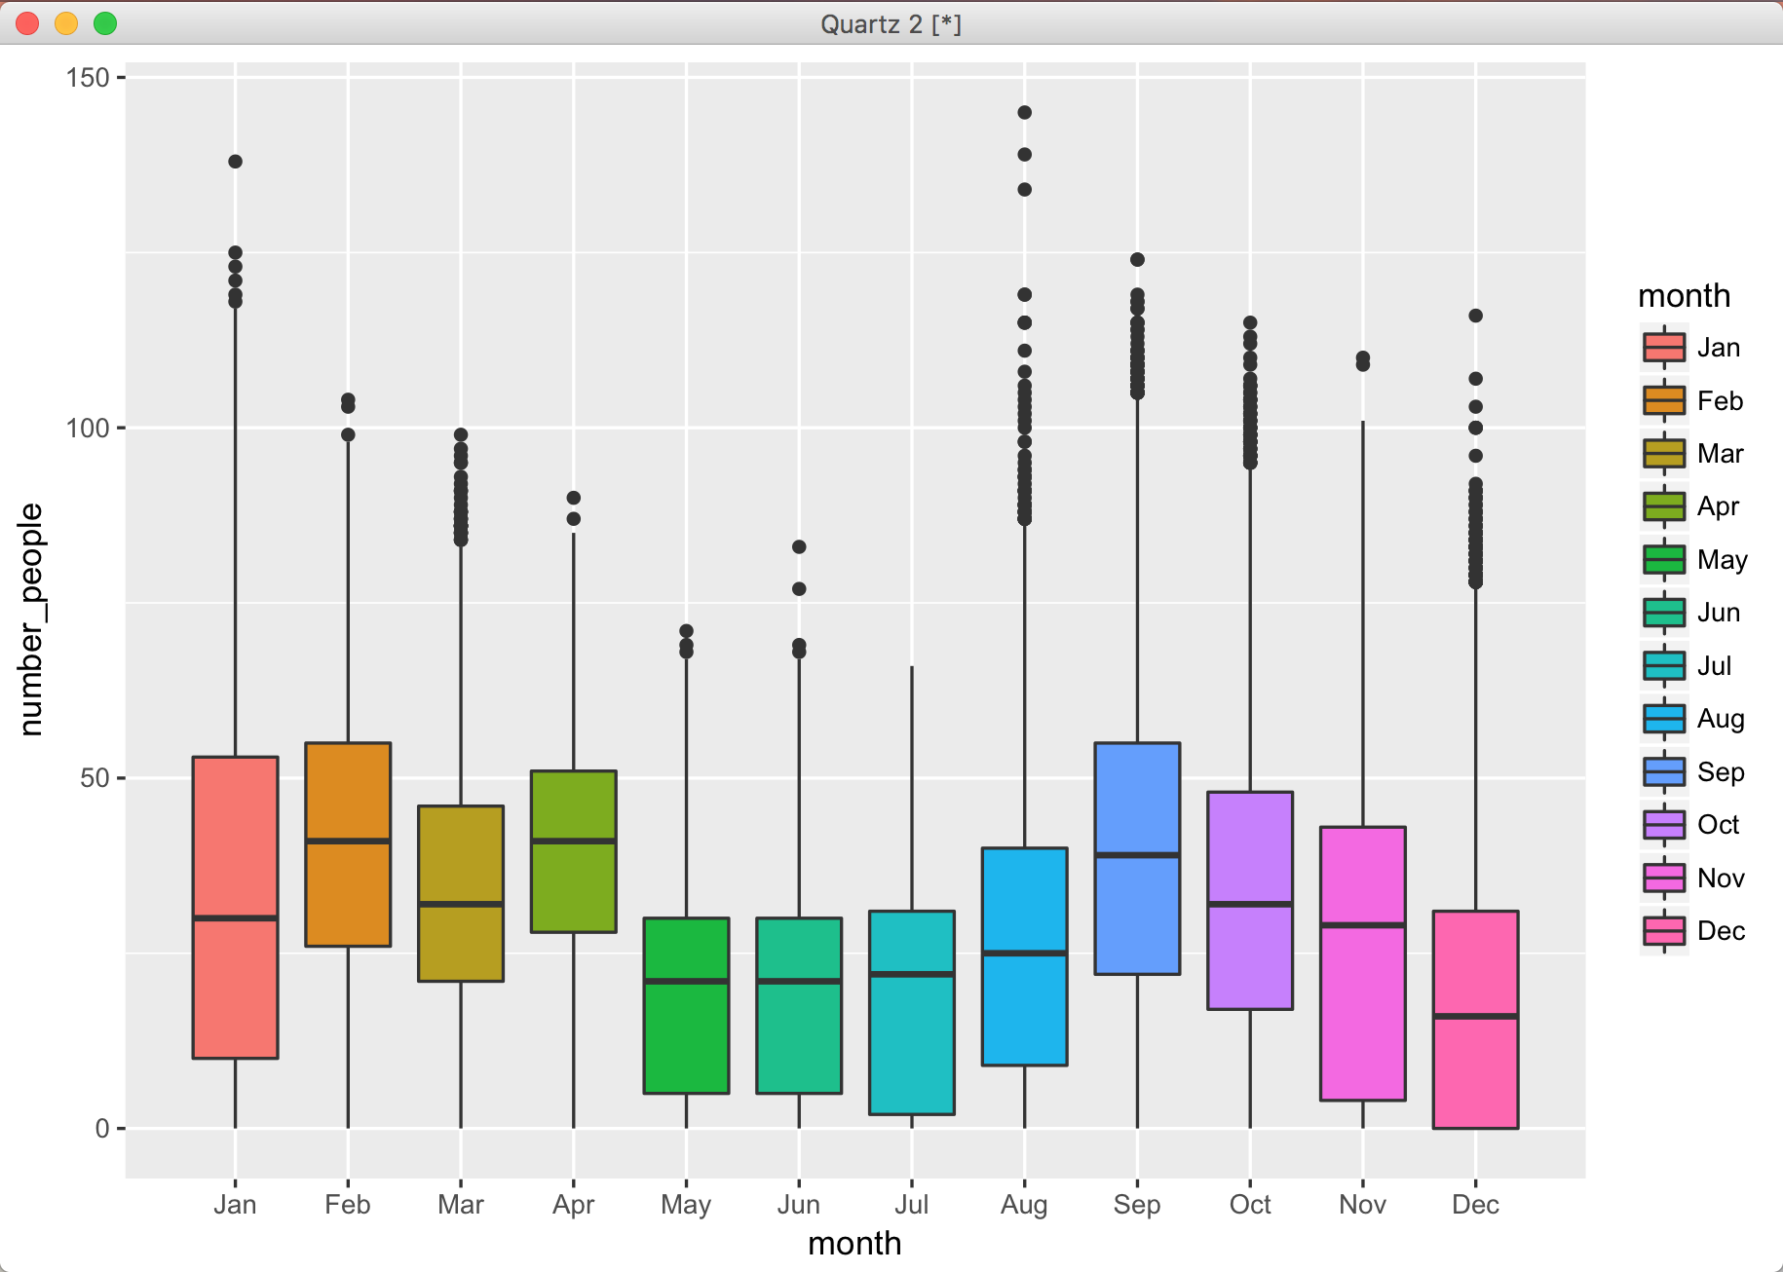
DATA VISUALISATION: MONTH-WISE BOX PLOT

Slide 17
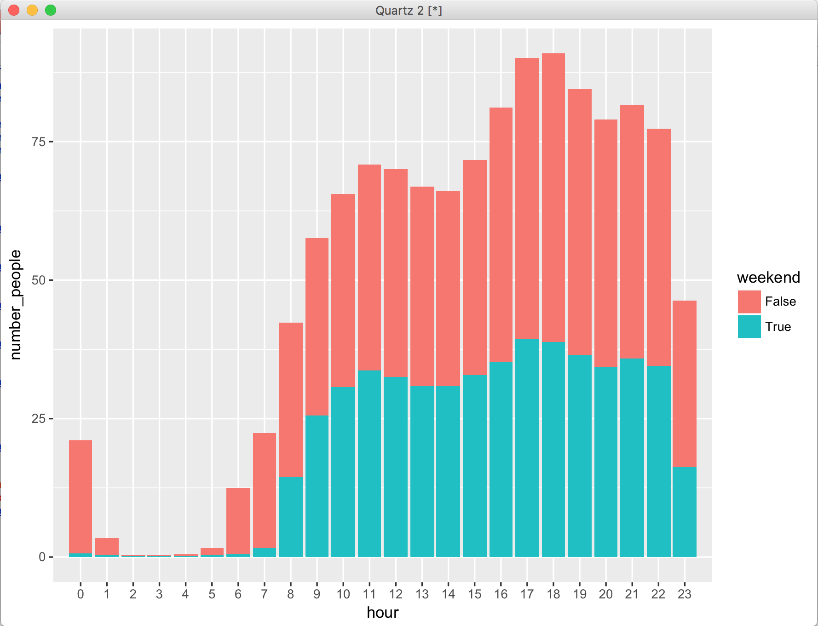
DATA VISUALISATION: HOUR-WISE STACKED GRAPH

Slide 18
CHALLENGES
Large dataset
Ordinal dependent variable
Data processing and conversion

Slide 19
LEARNING AND FUTURE SCOPE
Advanced Logistic Regression analysis: Ordinal Logistic Regression
Stacked bar graph
New libraries like MASS and e1071
Improvements and Future Scope
Can improve accuracy of model by applying classification method like Support Vector Machine (SVM) and trees
Can do predictions on weekly basis
Gym planning application

Slide 20
REFERENCES
https://www.analyticsvidhya.com/blog/2016/02/multinomial-ordinal-logistic-regression/
https://www.youtube.com/watch?v=z5Cvie9uqMM
https://www.r-bloggers.com/how-to-multinomial-regression-models-in-r/

Slide 21
Thank You!! Any Questions?

